Slide 1
The Wireless Channel
Shivkumar Kalyanaraman
shivkumar-k AT in DOT ibm DOT com
http://www.shivkumar.org
Google: “shivkumar ibm rpi”
Slides based upon books by Tse/Viswanath, Goldsmith, Rappaport, J.Andrews etal

Slide 2
Wireless Channel is Very Different!
Wireless channel “feels” very different from a wired channel.
Not a point-to-point link
Variable capacity, errors, delays
Capacity is shared with interferers
Characteristics of the channel appear to change randomly with time, which makes it difficult to design reliable systems with guaranteed performance.
Cellular model vs reality:
Cellular system designs are interference-limited, i.e. the interference dominates the noise floor

Slide 3
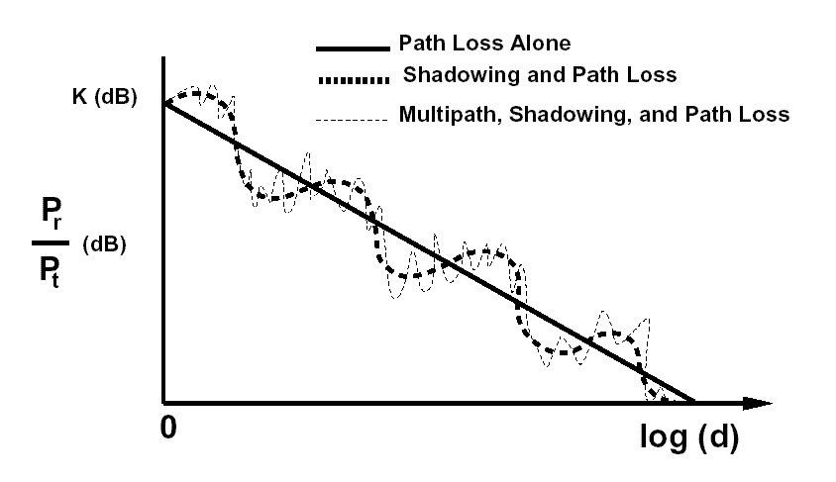
Basic Ideas: Path Loss, Shadowing, Fading
Variable decay of signal due to environment, multipaths, mobility
Source: A. Goldsmith book

Slide 4
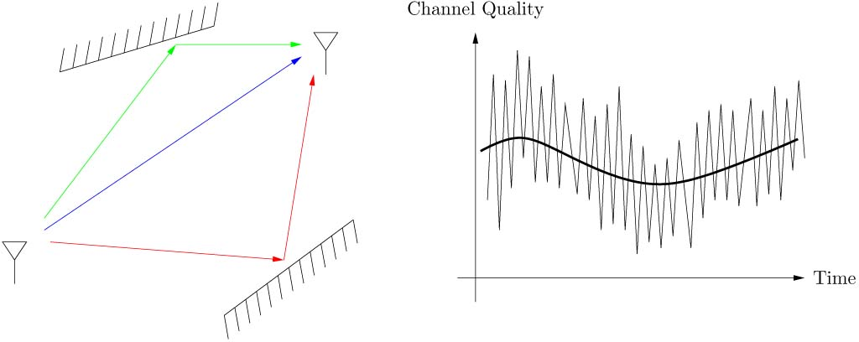
Small-Scale Fading: Multipath (frequency domain) & Mobility (time-domain)
Channel varies at two spatial scales:
* Large scale fading: path loss, shadowing
* Small scale fading:
Multi-path fading (frequency selectivity, coherence b/w, ~500kHz),
Doppler (time-selectivity, coherence time, ~2.5ms)

Slide 5
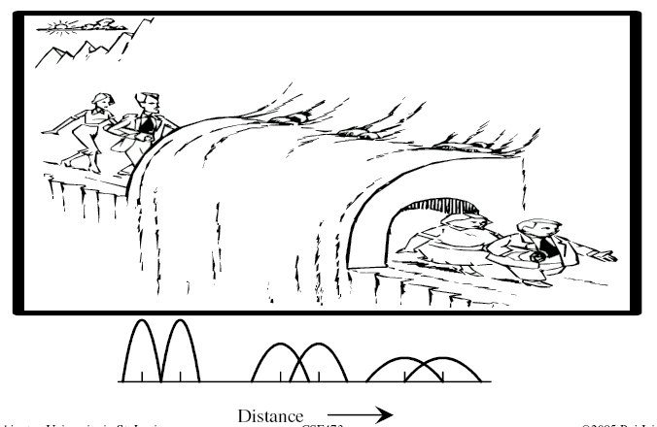
Effect of Multipath fading: Attenuation, Dispersion leading to ISI!
Inter-symbol interference (ISI)
Source: Prof. Raj Jain, WUSTL

Slide 6
Large-scale Fading: Path Loss, Shadowing
More important for cell site planning, less for communication system design.

Slide 7
Free-Space-Propagation
If oscillating field at transmitter, it produces three components:
The electrostatic and inductive fields that decay as 1/d² or 1/d³
The EM radiation field that decays as 1/d (power decays as 1/d²)

Slide 8
Simplified Path Loss Model
Used when path loss dominated by reflections.
Most important parameter is the path loss exponent γ, determined empirically.
Cell design impact: If the radius of a cell is reduced by half when the propagation path loss exponent is 4, the transmit power level of a base station is reduced by 12dB (=10 log 16 dB).
Costs: More base stations, frequent handoffs

Slide 9
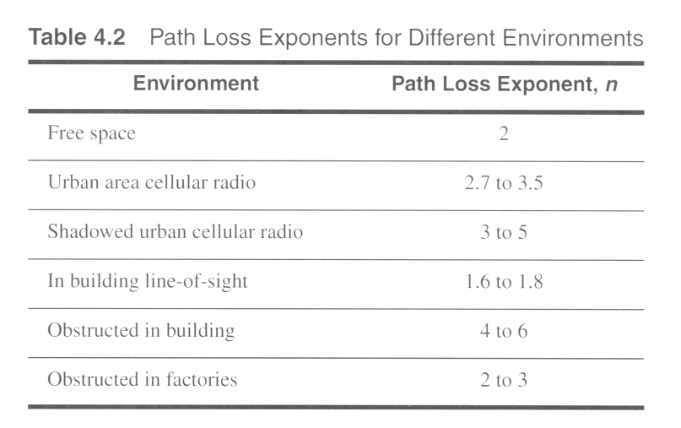
Typical large-scale path loss
Source: Rappaport and A. Goldsmith books
Notes:
Fig. 2.15

Slide 10
Path Loss Effects: Carrier Frequency
10m
W
Note: effect of frequency f: 900 Mhz vs 5 Ghz.
Either the receiver must have greater sensitivity or the sender must pour 44W of power, even for 10m cell radius!
Source: A. Goldsmith book

Slide 11
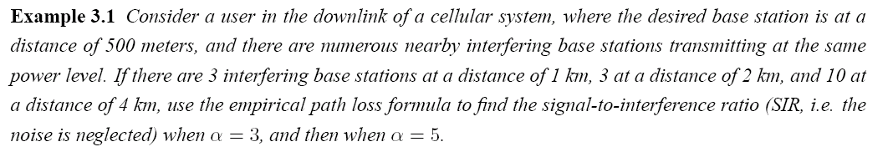


Path Loss: Interference & Cell Sizing
Desired signal power:
Interference power:
SIR:
SIR is much better with higher path loss exponent (α = 5)!
Higher path loss, smaller cells => lower interference, higher SIR
Source: J. Andrews et al book

Slide 12
Critical Distance & cell size design
Design the cell size to be < critical distance to get:
O(d⁻²) power decay in cell and…
O(d⁻⁴) power decay outside the cell!
Cell radii are typically much smaller than critical distance
Source: A. Goldsmith book

Slide 13
Path Loss: Range vs Bandwidth Tradeoff
Frequencies < 1 GHz are often referred to as “beachfront” spectrum. Why?
1. High frequency RF electronics have traditionally been harder to design and manufacture, and hence more expensive. [less so nowadays]
2. Pathloss increases ~ O(f_{c}²)
A signal at 3.5 GHz (one of WiMAX’s candidate frequencies) will be received with about 20 times less power than at 800 MHz (a popular cellular frequency).
Effective path loss exponent also increases at higher frequencies, due to increased absorption and attenuation of high frequency signals
Tradeoff:
Bandwidth at higher carrier frequencies is more plentiful and less expensive.
Does not support large transmission ranges.
(also increases problems for mobility/Doppler effects etc)
Broadband Wireless Choice:
Pick any two out of three: high data rate, high range, low cost.

Slide 14
Empirical Models
Okumura model
Empirically based (site/freq specific)
Awkward (uses graphs)
Hata model
Analytical approximation to Okumura model
Cost 136 Model:
Extends Hata model to higher frequency (2 GHz)
Walfish/Bertoni:
Cost 136 extension to include diffraction from rooftops
Commonly used in cellular system simulations

Slide 15
Empirical Path Loss: Okamura, Hata, COST231
Empirical models include effects of path loss, shadowing and multipath.
Multipath effects are averaged over several wavelengths: local mean attenuation (LMA)
Empirical path loss for a given environment is the average of LMA at a distance d over all measurements
Okamura: based upon Tokyo measurements. 1-100 lm, 150-1500MHz, base station heights (30-100m), median attenuation over free-space-loss, 10-14dB standard deviation.
Hata: closed form version of Okamura
COST 231: Extensions to 2 GHz
Source: A. Goldsmith book

Slide 16
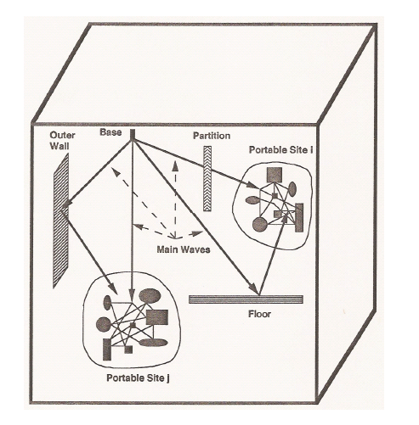
Indoor Models
900 MHz: 10-20dB attenuation for 1-floor, 6-10dB/floor for next few floors (and frequency dependent)
Partition loss each time depending upton material (see table)
Outdoor-to-indoor: building penetration loss (8-20 dB), decreases by 1.4dB/floor for higher floors. (reduced clutter)
Windows: 6dB less loss than walls (if not lead lined)

Slide 17
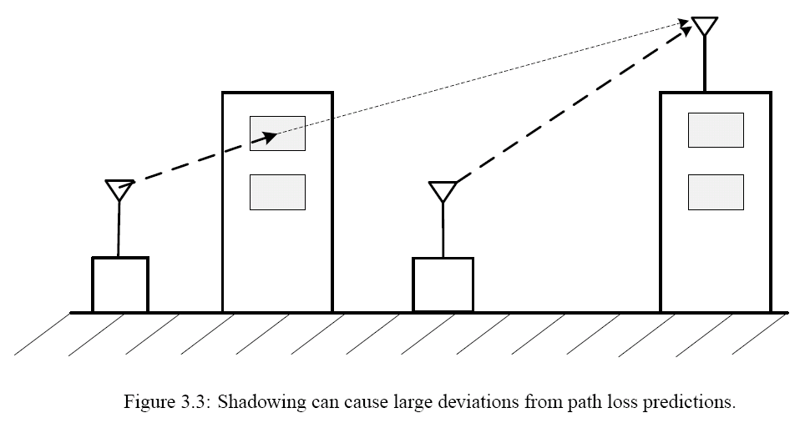
Shadowing
Log-normal model for shadowing r.v. (χ)

Slide 18
Log-Normal Shadowing
Assumption: shadowing is dominated by the attenuation from blocking objects.
Attenuation of for depth d:
s(d) = e^{−αd},
(α: attenuation constant).
Many objects:
s(d_{t}) = e^{−α∑ di} = e^{−αdt} ,
d_{t} = ∑ d_{i} is the sum of the random object depths
Cental Limit Theorem (CLT): αd_{t} = log s(d_{t}) ~ N(μ, σ).
log s(d_{t}) is therefore log-normal

Slide 19

Outage Probability: Path Loss & Shadowing
dBm
Need to improve receiver sensitivity (i.e. reduce Pmin) for better coverage.

Slide 20
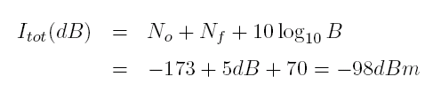
Shadowing: Adaptive Modulation Design
Simple path loss/shadowing model:
Find Pr:
Find Noise power:

Slide 21
Shadowing: Adaptive Modulation Design
SINR:
Without shadowing (χ = 0), BPSK works 100%, 16QAM fails all the time.
With shadowing (σ_{s}= 6dB):
BPSK: 16 QAM
75% of users can use BPSK modulation and hence get a PHY data rate of 10 MHz · 1 bit/symbol ·1/2 = 5 Mbps
Less than 1% of users can reliably use 16QAM (4 bits/symbol) for a more desirable data rate of 20 Mbps.
Interestingly for BPSK, w/o shadowing, we had 100%; and 16QAM: 0%!

Slide 22
Path Loss Models: Summary
Path loss models simplify Maxwell’s equations
Models vary in complexity and accuracy
Power falloff with distance is proportional to d² in free space, d⁴ in two path model
General ray tracing computationally complex
Empirical models used in 2G/3G/4G simulations
Main characteristics of path loss captured in simple model P_{r}=P_{t}K[d₀/d]^{γ}
Shadowing modeled as log-normal allows the use of adaptive modulation; but complicates cell-site design

Slide 23
Small-Scale Fading: Rayleigh/Ricean Models, Multipath & Doppler

Slide 24
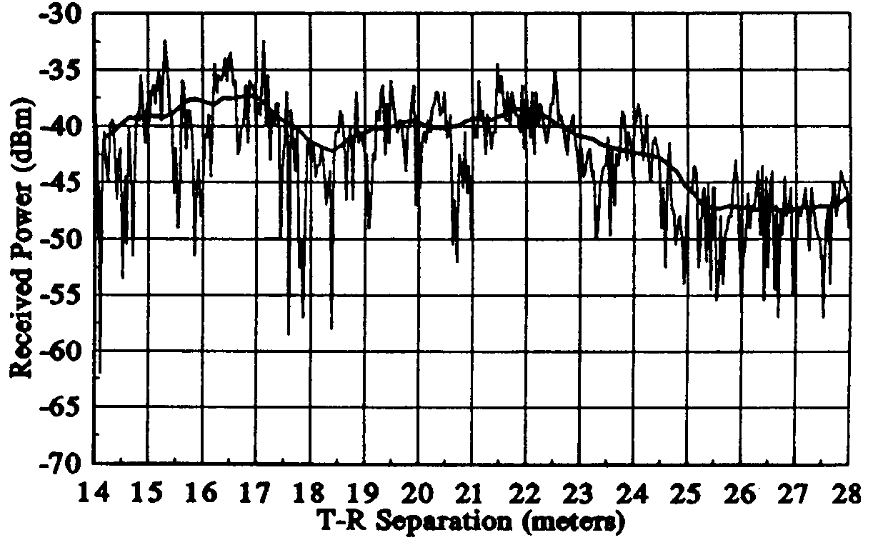
Fading: Small Scale vs Large Scale

Slide 25
Small-scale Multipath fading: System Design
Wireless communication typically happens at very high carrier frequency. (eg. f_{c} = 900 MHz or 1.9 GHz for cellular)
Multipath fading due to constructive and destructive “self” interference of the transmitted waves.
Channel varies when mobile moves a distance of the order of the carrier wavelength. This is about 0.3 m for 900 Mhz cellular.
For vehicular speeds, this translates to channel variation of the order of 100 Hz.
Primary driver behind wireless communication system design.

Slide 26
#1: Single-Tap (Narrow-Band) Channel: Rayleigh Dist’n
Path loss, shadowing => average signal power loss
Fading around this average.
Subtract out average => fading modeled as a zero-mean random process
Narrowband Fading channel: Each symbol is long in time
The channel h(t) is assumed to be uncorrelated across symbols => single “tap” in time domain.
Fading w/ many scatterers: Central Limit Theorem
In-phase (cosine) and quadrature (sine) components of the snapshot r(0), denoted as r_{I} (0) and r_{Q}(0) are independent Gaussian random variables.
Envelope Amplitude:
Received Power:

Slide 27
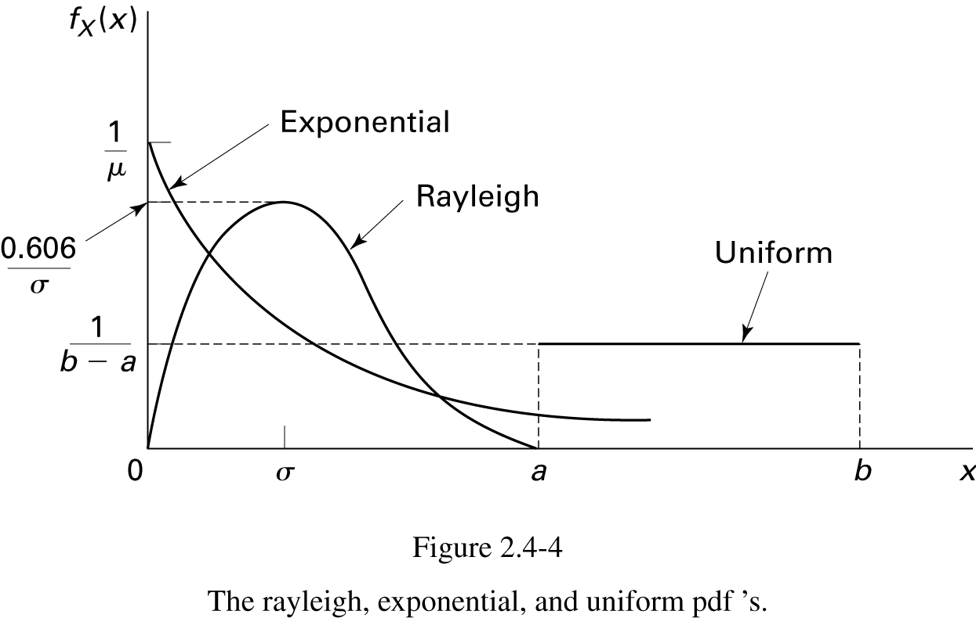
Normal Vector R.V, Rayleigh, Chi-Squared
X = [X₁, …, X_{n}] is Normal random vector
||X|| is Rayleigh { eg: magnitude of a complex gaussian channel X₁ + jX₂ }
||X||² is Chi-Squared w/ n-degrees of freedom
When n = 2, chi-squared becomes exponential. {eg: power in
complex gaussian channel: sum of squares…}

Slide 28
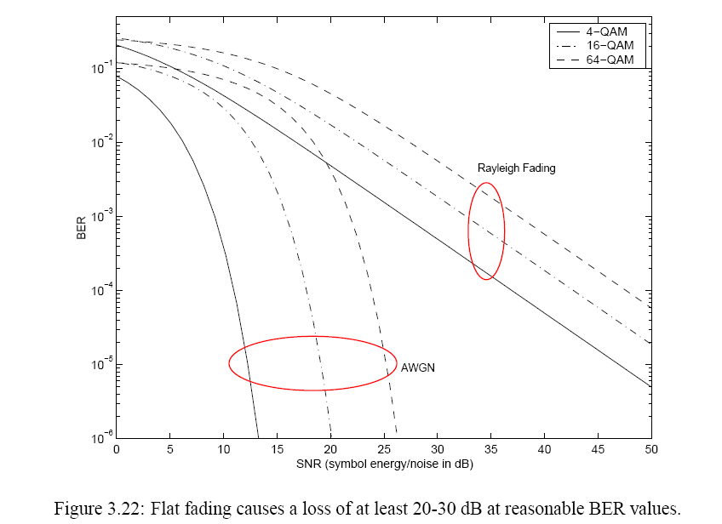
Effect of Rayleigh Fading

Slide 29
#2: Broadband / Multipath Channel: Power-Delay Profile (PDP)
Power
path-1
path-2
path-3
multi-path propagation
path-2
Path Delay
path-1
path-3
Mobile Station (MS)
Base Station (BS)
Channel Impulse Response:
Channel amplitude |h| correlated at delays τ.
Each “tap” value @ kTs Rayleigh distributed
(actually the sum of several sub-paths)

Slide 30
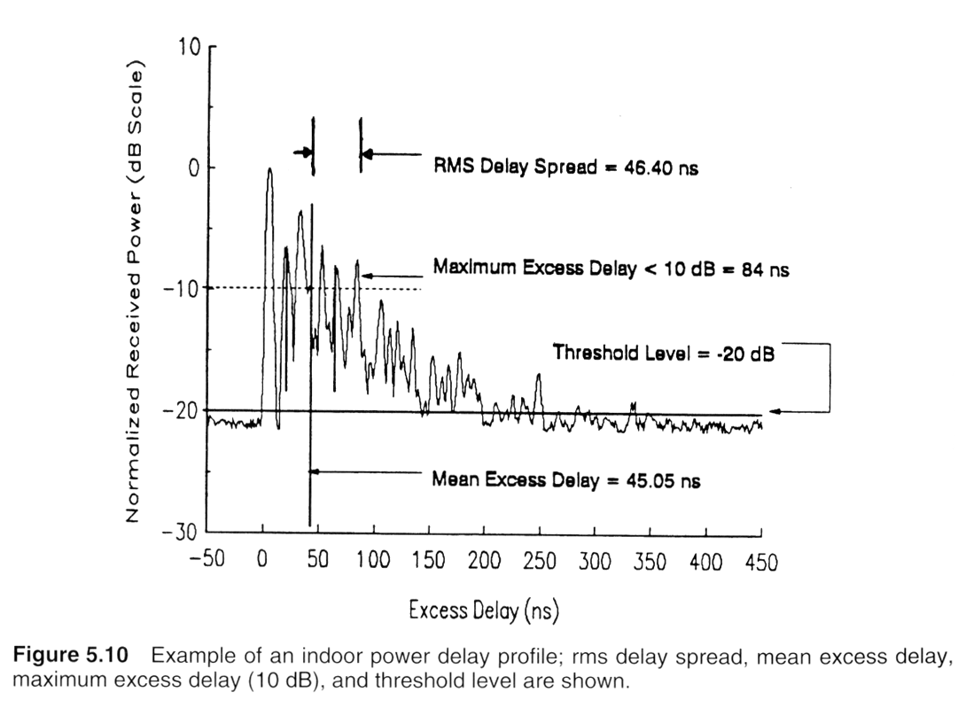
Eg: Power Delay Profile (WLAN/indoor)

Slide 31
Multipath: Time-Dispersion => Frequency Selectivity
The impulse response of the channel is correlated in the time-domain (sum of “echoes”)
Manifests as a power-delay profile, dispersion in channel autocorrelation function A(Δτ)
Equivalent to “selectivity” or “deep fades” in the frequency domain
Delay spread: τ ~ 50ns (indoor) – 1μs (outdoor/cellular).
Coherence Bandwidth: Bc = 500kHz (outdoor/cellular) – 20MHz (indoor)
Implications: High data rate: symbol smears onto the adjacent ones (ISI).
Multipath effects
~ O(1μs)

Slide 32
#3: Doppler: Time-varying Non-Stationary Channel.
Set of multipaths
changes ~ O(5 ms)

Slide 33
Doppler: Dispersion (Frequency) => Time-Selectivity
The doppler power spectrum shows dispersion/flatness ~ doppler spread (100-200 Hz for vehicular speeds)
Equivalent to “selectivity” or “deep fades” in the time domain correlation envelope.
Each envelope point in time-domain is drawn from Rayleigh distribution. But because of Doppler, it is not IID, but correlated for a time period ~ Tc (correlation time).
Doppler Spread: Ds ~ 100 Hz (vehicular speeds @ 1GHz)
Coherence Time: Tc = 2.5-5ms.
Implications: A deep fade on a tone can persist for 2.5-5 ms! Closed-loop estimation is valid only for 2.5-5 ms.

Slide 34
Fading Summary: Time-Varying Channel Impulse Response
#1: At each tap, channel gain |h| is a Rayleigh distributed r.v.. The random process is not IID.
#2: Response spreads out in the time-domain (τ), leading to inter-symbol interference and deep fades in the frequency domain: “frequency-selectivity” caused by multi-path fading
#3: Response completely vanish (deep fade) for certain values of t: “Time-selectivity” caused by doppler effects (frequency-domain dispersion/spreading)

Slide 35
Dispersion-Selectivity Duality

Slide 36
Dispersion-Selectivity Duality (Contd)

Slide 37
Fading: Jargon
Flat fading: no multipath ISI effects.
Eg: narrowband, indoors
Frequency-selective fading: multipath ISI effects.
Eg: broadband, outdoor.
Slow fading: no doppler effects.
Eg: indoor Wifi home networking
Fast Fading: doppler effects, time-selective channel
Eg: cellular, vehicular
Broadband cellular + vehicular => Fast + frequency-selective

Slide 38
Effect of Fading on Communication System Design

Slide 39
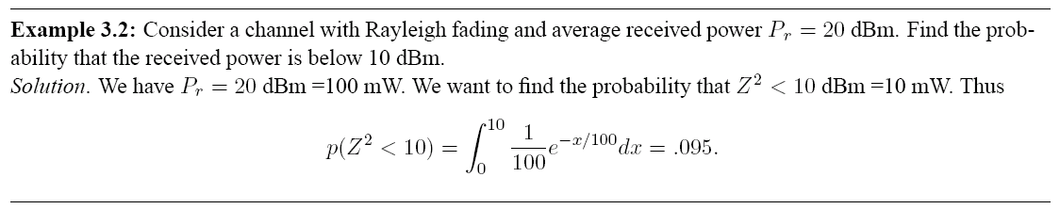
Rayleigh Fading Example
Non-trivial (1%) probability of very deep fades.
These very deep fades occur often enough to dominate system performance

Slide 40
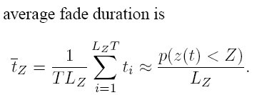
Rayleigh Fading (Fade Duration Example)
L_{z}: Level Crossing Rate
Faster motion & doppler better (get out of fades)!

Slide 41
Power Delay Profile => Inter-Symbol interference
Symbol
Time
Symbol Time
Higher bandwidth => higher symbol rate, and smaller time per-symbol
Lower symbol rate, more time, energy per-symbol
If the delay spread is longer than the symbol-duration, symbols will “smear” onto adjacent symbols and cause symbol errors
Power
path-1
path-2
path-3
Path Delay
Delay spread
~ 1 μs
Symbol Error!
If symbol rate
~ Mbps
No Symbol Error! (~kbps)
(energy is collected
over the full symbol period
for detection)
OFDM: Uses a number of “sub-carriers” to ensure “flat fading” in each sub-carrier

Slide 42
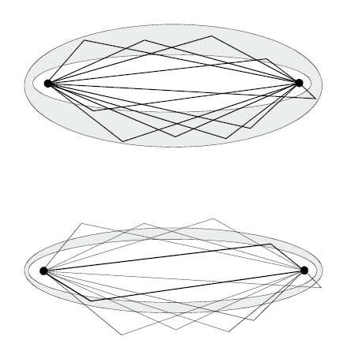
Multipaths & Bandwidth (Contd)
Even though many paths with different delays exist (corresponding to finer-scale bumps in h(t))…
Smaller bandwidth => fewer channel taps (remember Nyquist?)
The receiver will simply not sample several multipaths, and interpolate what it does sample => smoother envelope h(t)
The power in these multipaths cannot be combined!
In CDMA Rake (Equalization) Receiver, the power on multipath taps is received (“rake fingers”), gain adjusted and combined.
Similar to bandpass vs matched filtering (see next slide)

Slide 43
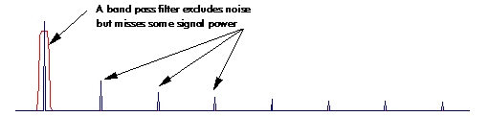
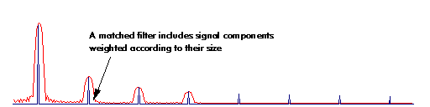
Rake Equalization Analogy: Bandpass vs Matched Filtering
Simple Bandpass (low bandwidth) Filter:
excludes noise, but misses some signal power in other mpath “taps”
Matched Filter: includes more signal power, weighted according to size
=> maximal noise rejection & signal power aggregation!

Slide 44
Fading: Design Impacts (Eg: Wimax)

Slide 45
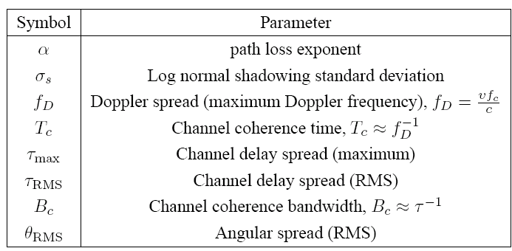
Key Wireless Channel Parameters

Slide 46
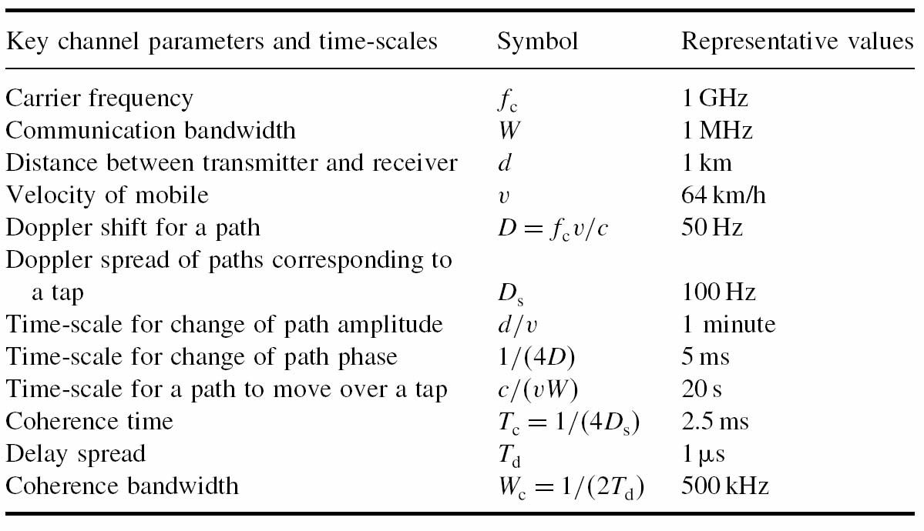
Fading Parameter Values

Slide 47
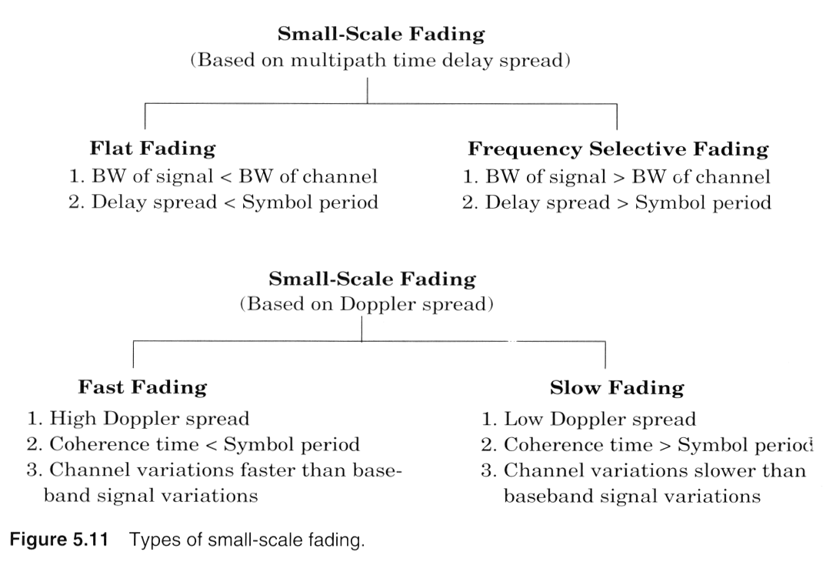
Small-Scale Fading Summary

